Slide 1
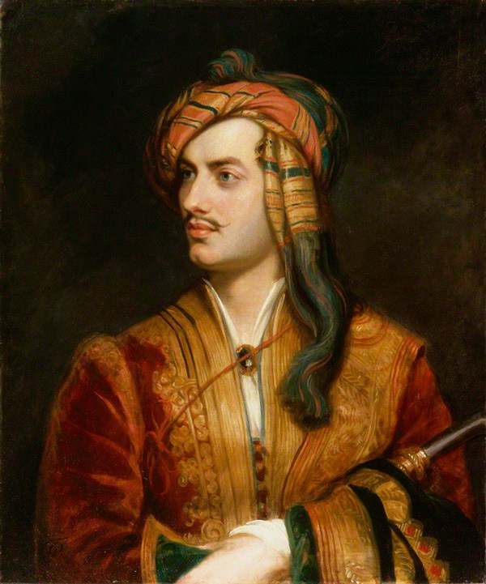
The Bot Framework
The poetry of programming
Daniel Egan
Bret Stateham
Michael Washington

Slide 2
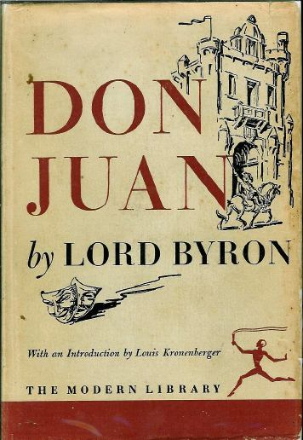
Lord Byron
1788 - 1824
I know that two and two make four - and should be glad to prove it too if I could - though I must say if by any sort of process I could convert 2 and 2 into five it would give me much greater pleasure. ~Lord Byron

Slide 3
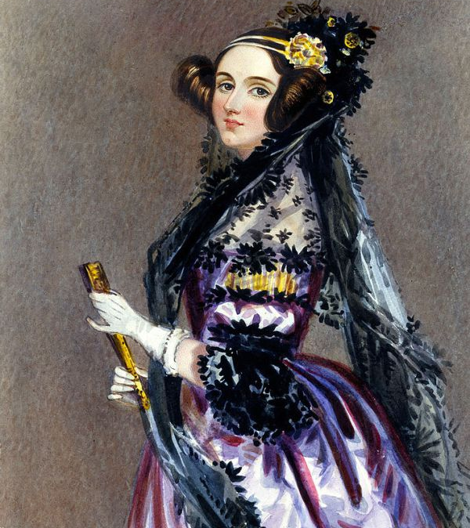
Augusta Ada Byron
Countess of Lovelace

Slide 4
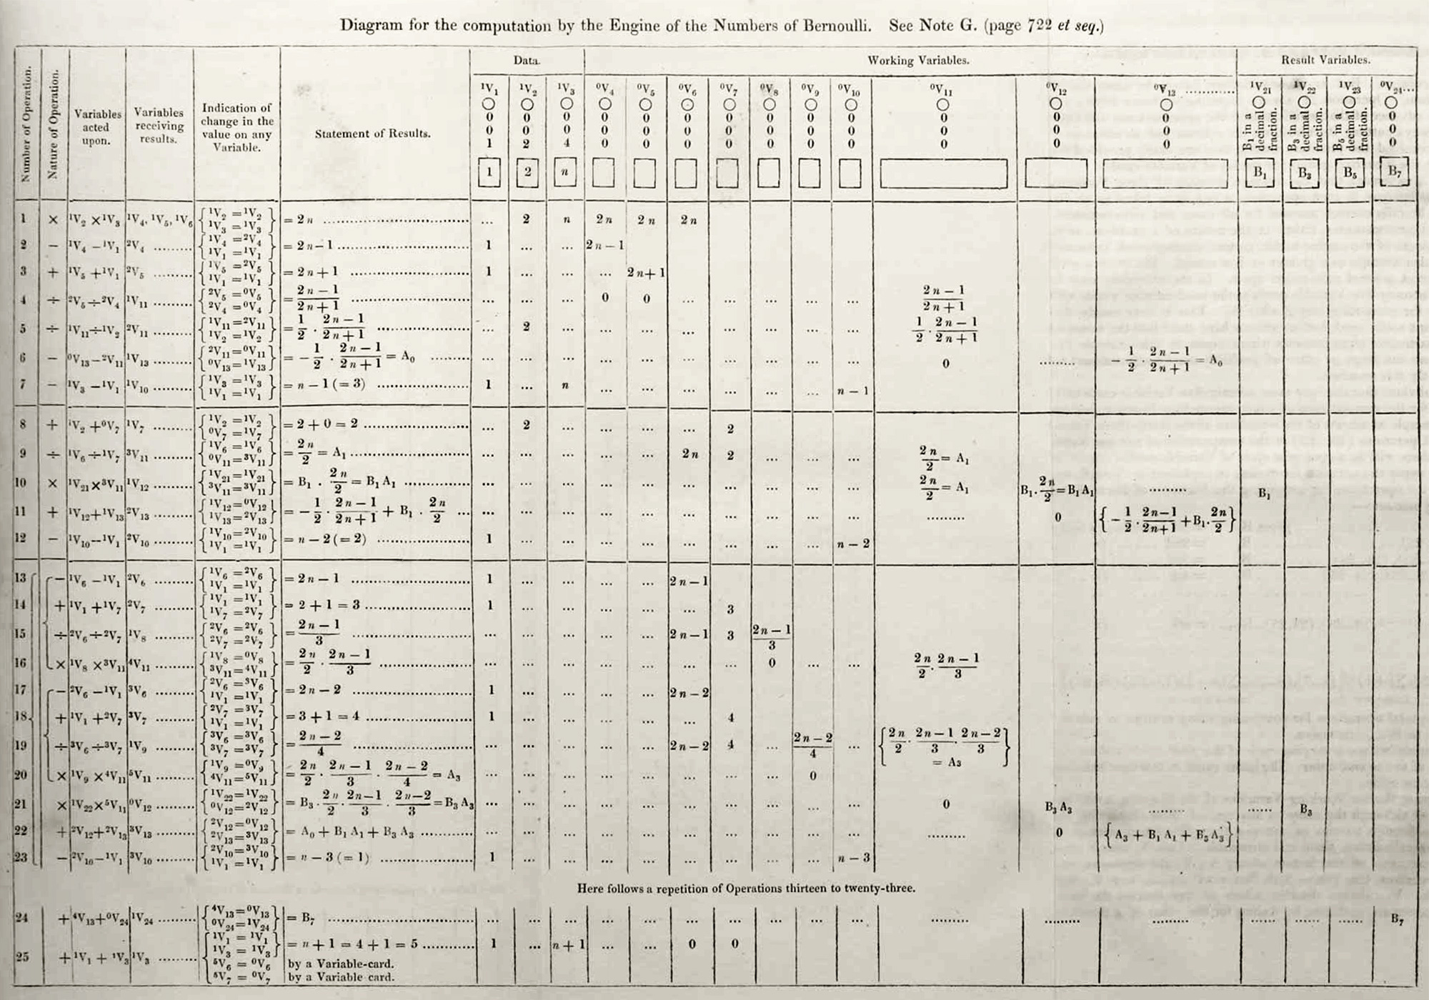
Ada Lovelace
1815 - 1852
Credited (mostly) as first programmer

Slide 5
Ada Lovelace
1815 - 1852
Credited (mostly) as first programmer
"The Analytical Engine has no pretensions whatever to originate anything. It can do whatever we know how to order it to perform. It can follow analysis; but it has no power of anticipating any analytical relations or truths."

Slide 6
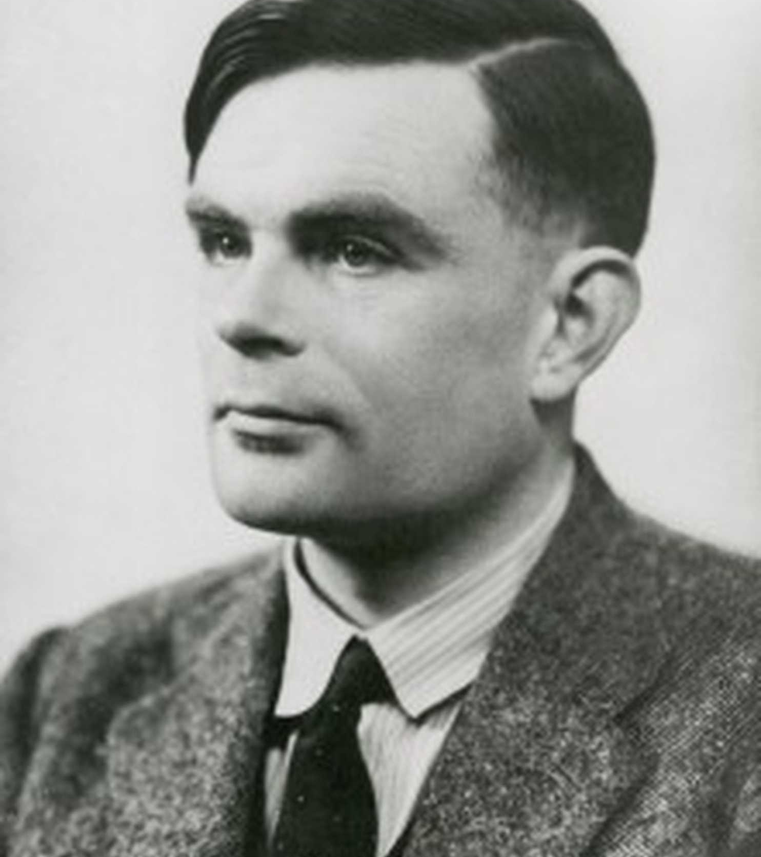
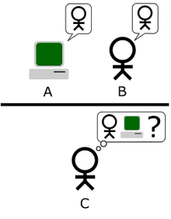
Alan Turing
1912 - 1954
"Can machines think? The Turing test."

Slide 7
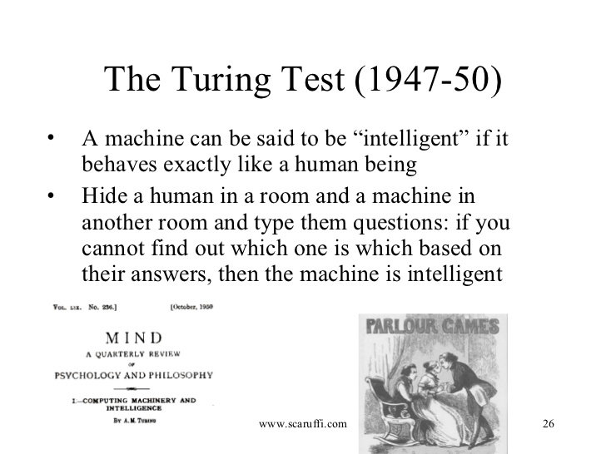

Slide 8
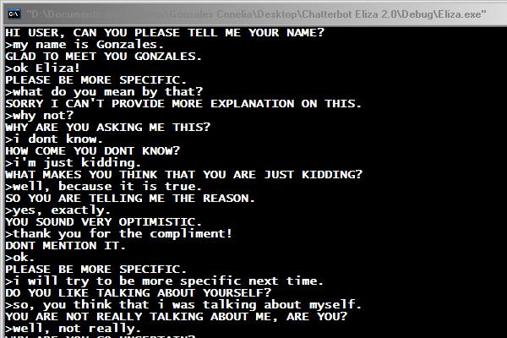
Eliza
The first chat bot
ELIZA was a tongue-in-cheek simulation
of a Rogerian therapist
Named after Eliza Doolittle from Pygmalion ( or My Fair Lady )
Written by Joeseph Weizenbau between 1964 and 1966 at the MIT Artificial Intelligence Laboratory
http://www.med-ai.com/models/eliza.html

Slide 9
Parry
The psychopath
written in 1972 by psychiatrist Kenneth Colby
PARRY attempted to simulate a person
with paranoid schizophrenia
In 1972 Eliza Met Parry
Where they hooked up over ARPANET

Slide 10
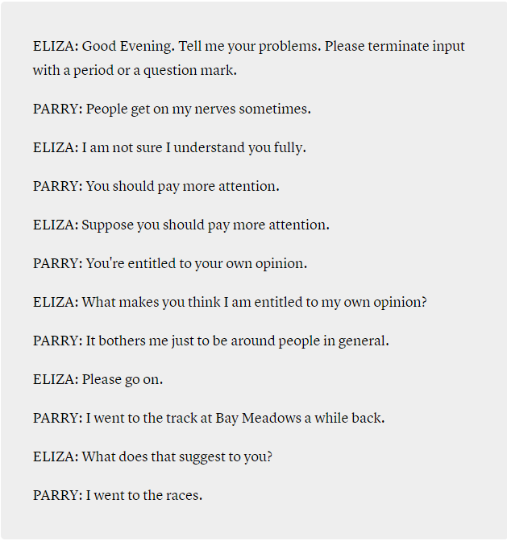
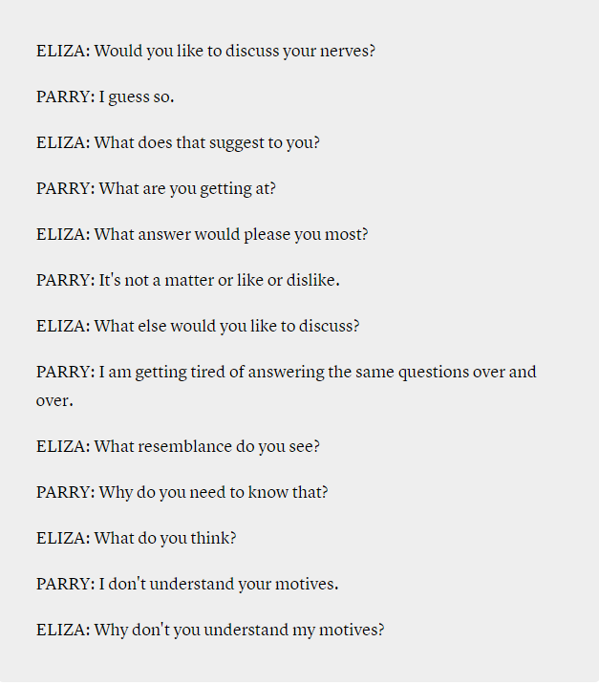
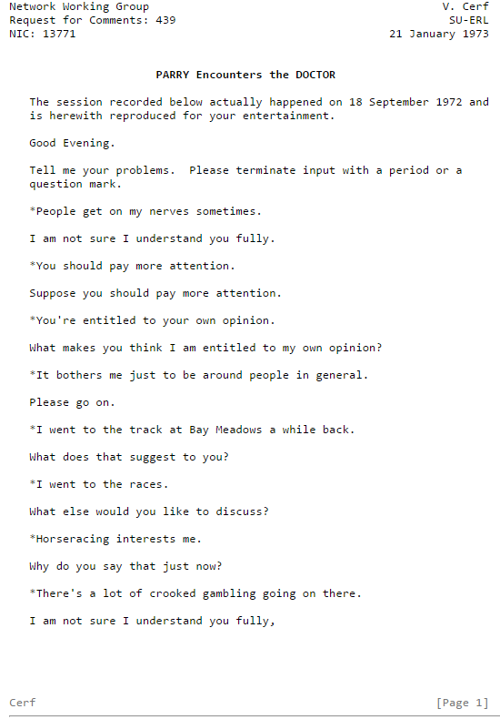
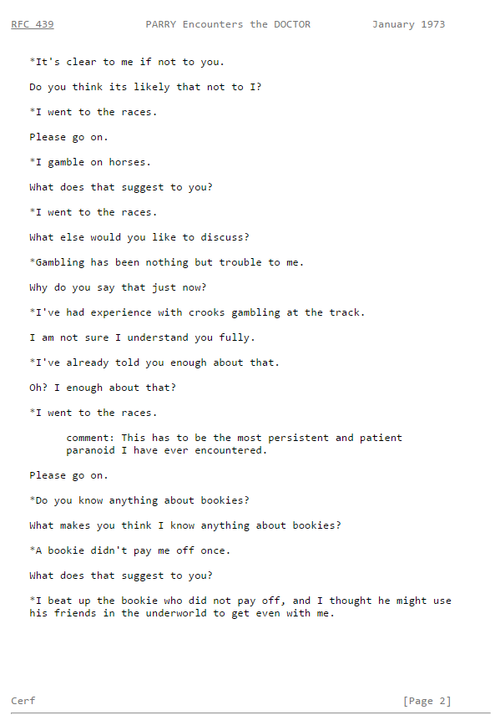

Slide 11
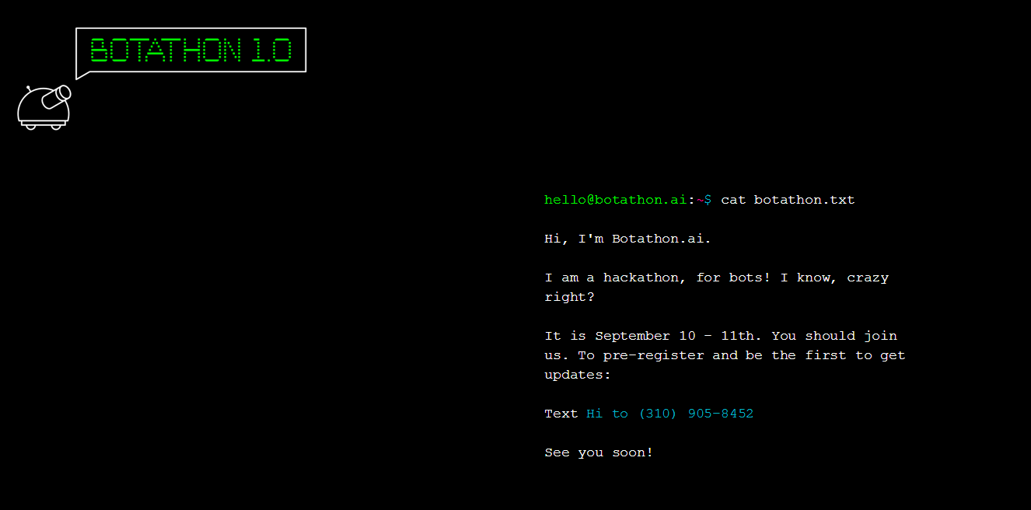
Why we are here www.botathon.ai

Slide 12
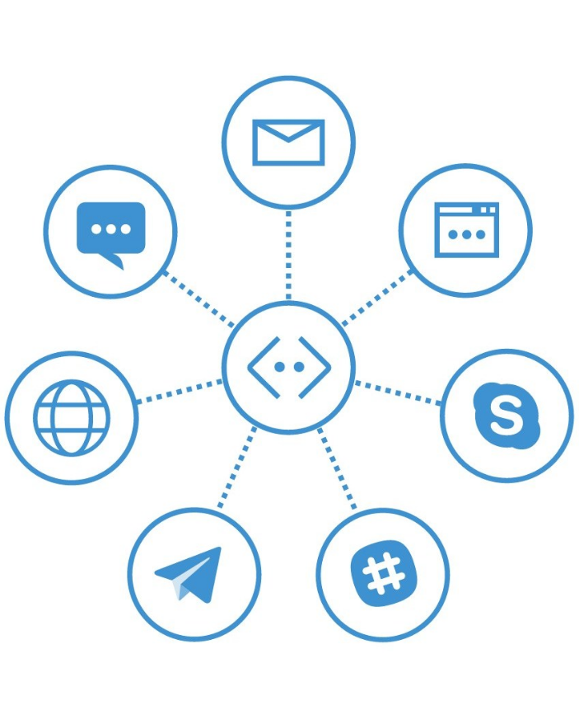
Agenda
Hello World
Setup and Install
BotBuilder
Connectors & Channels
Conversation Flow
Prompts and Actions
Determining Intent
Beyond Regex (LUIS)
Publishing
Ngrok or Localtunnel
Webchat & Skype
Emulating and testing

Slide 13
Technology Needed today Node
Installs
Node.js (and npm)
Ngrok
GIT (not necessary but helpful)
VS Code (or other code editor: Sublime, Atom, Notepad++, Vi, Vim, etc…)
Skype (If you want to test a Skype Bot)
Signups needed
MSID (live.com, outlook.com, Hotmail, etc…)
BotFramework.com
LUIS – Language Understanding Intelligent Services

Slide 14
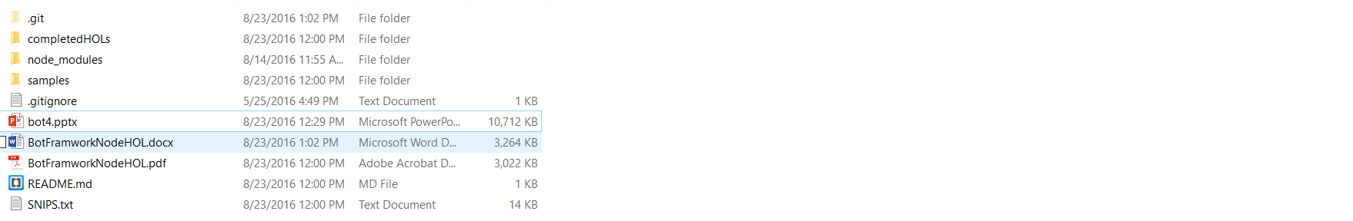
Content
https://github.com/DanielEgan/botworkshop
Hands On Labs Document (WORD)
Hands On Labs Document (PDF)
Code snippets for use with PDF

Slide 15
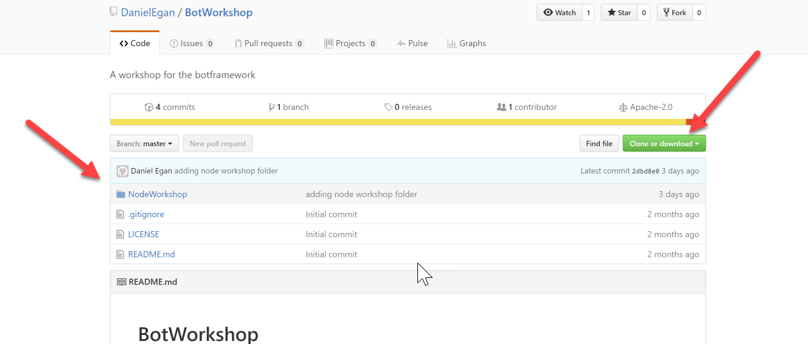
Content
https://github.com/DanielEgan/botworkshop

Slide 16
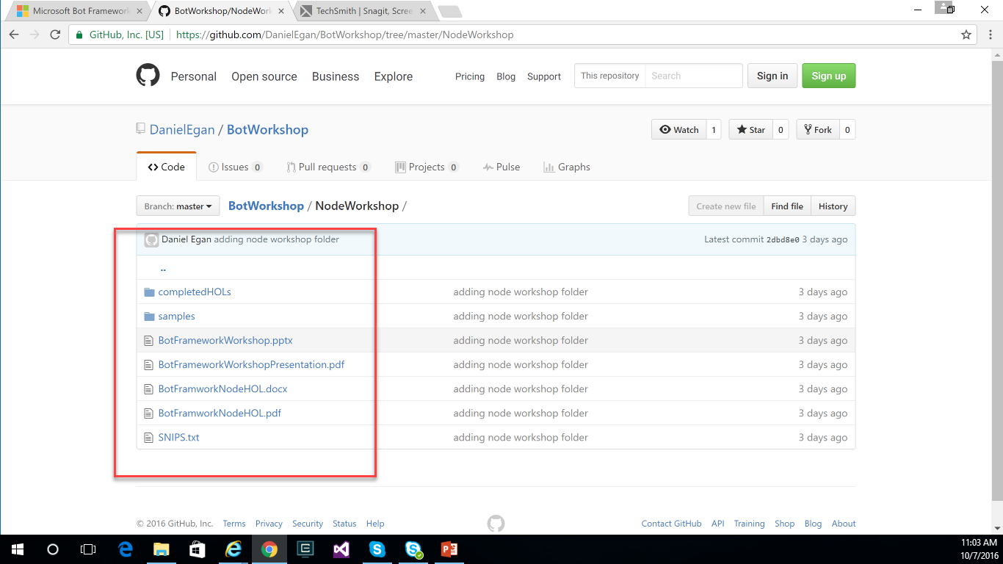
Content
https://github.com/DanielEgan/botworkshop

Slide 17
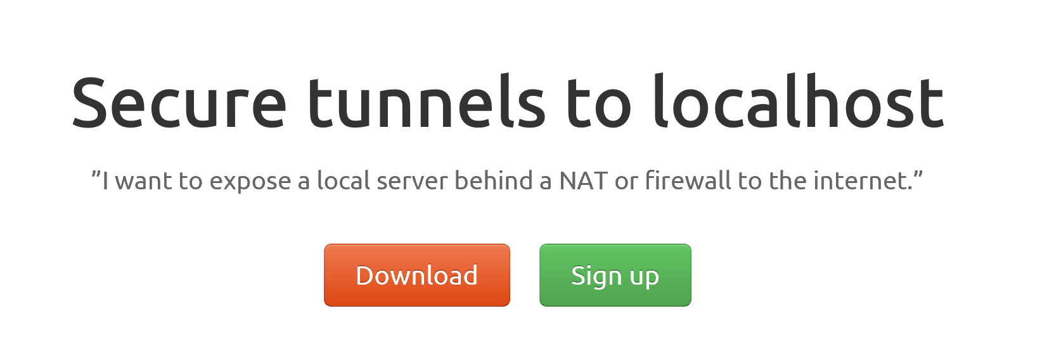
ngrok

Slide 18
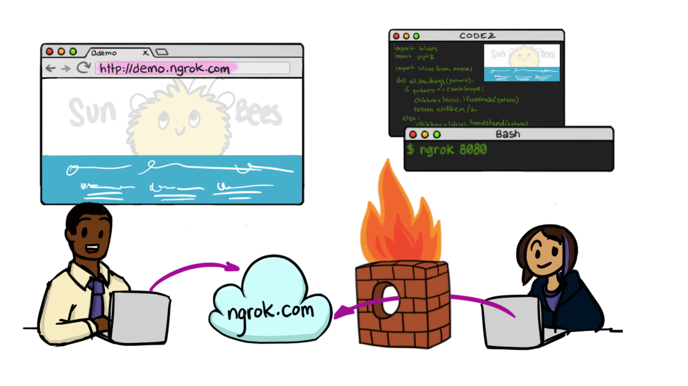

Slide 19
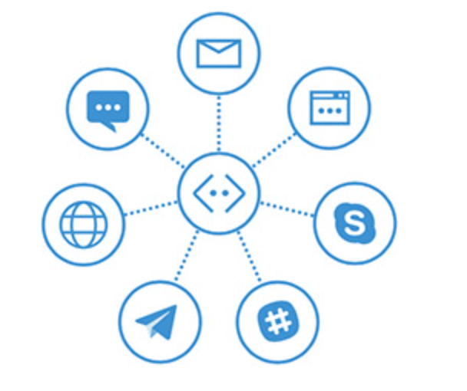
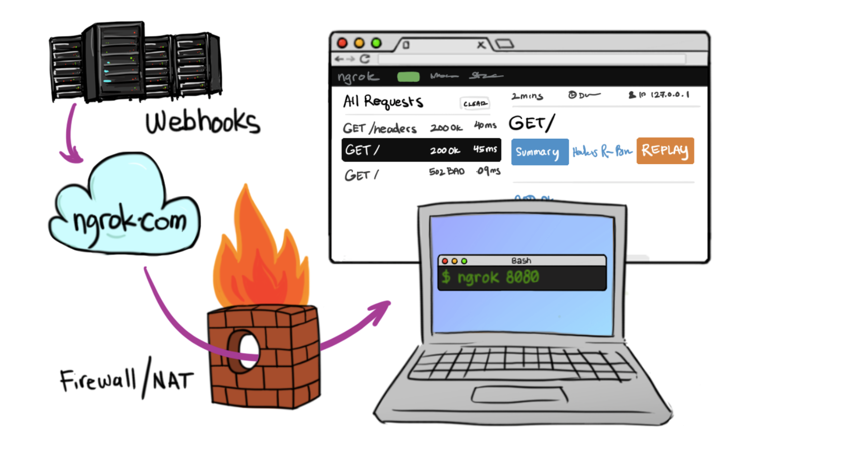
In Cloud
BotFramework

Slide 20
Hello World

Slide 21
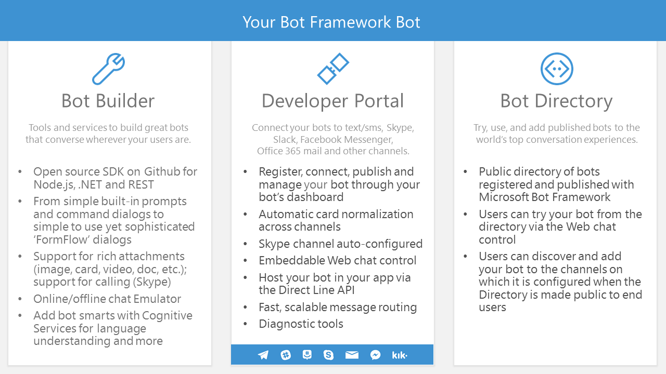

Slide 22
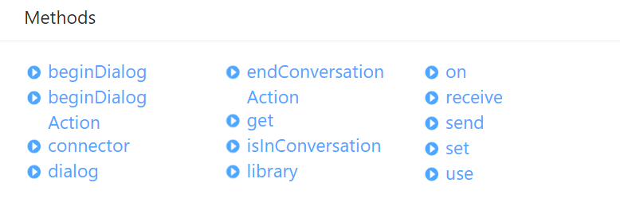
Universal Bot
The Brains of your bot.
Manages your bots conversations with users across multiple channels

Slide 23
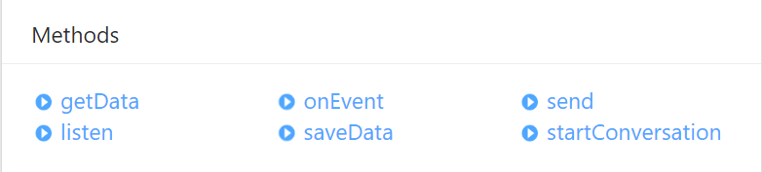
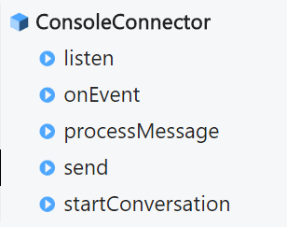
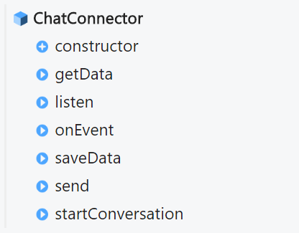
Chat & Console Connector
Connects a UniversalBot to multiple channels via the Bot Framework.

Slide 24
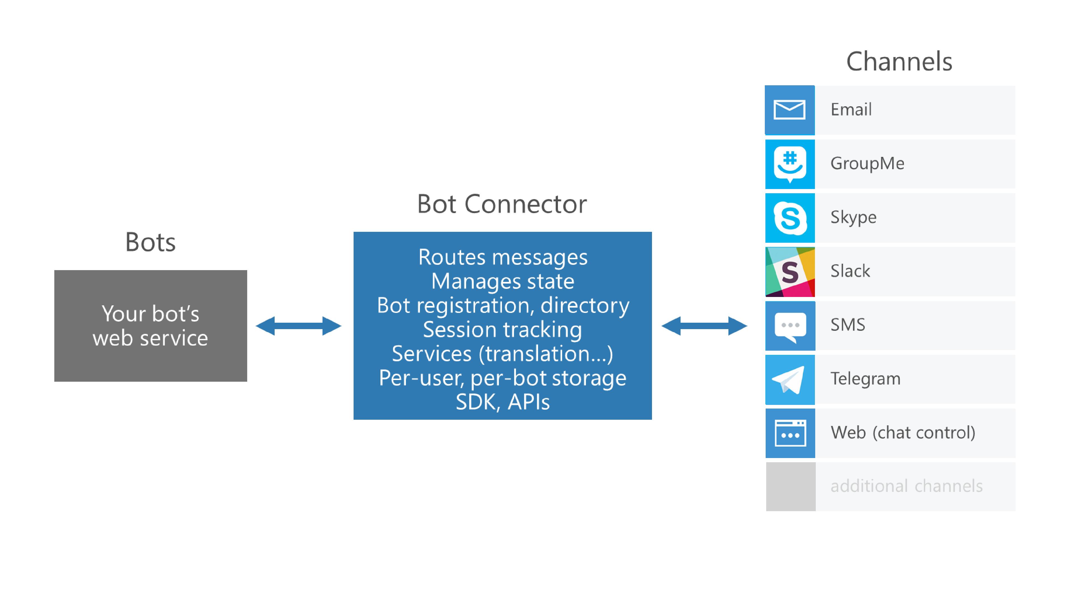
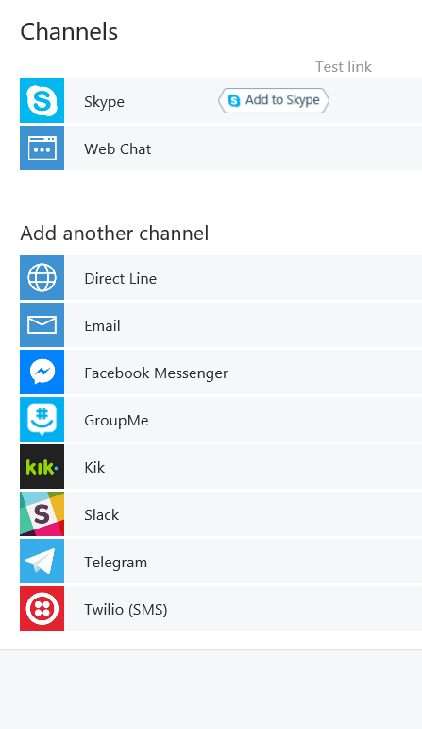

Slide 25

Demo: SimpleBot

Slide 26
Conversation Flow

Slide 27
Dialogs = Routing
Incoming Request
Parse URL
Find Matching Route
Route Found?
No
Yes
404 Error
Process Request

Slide 28
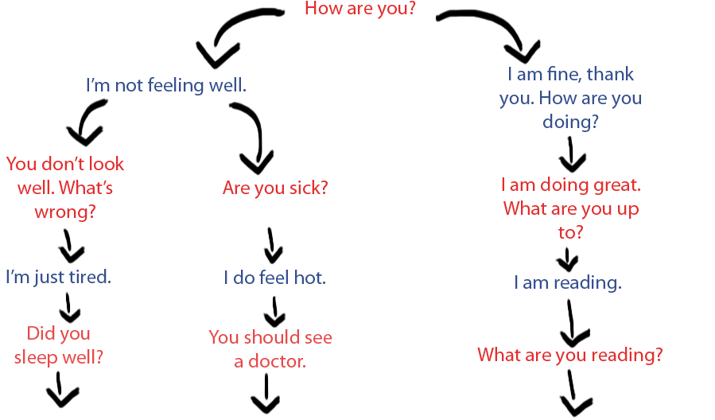
Dialogs = Routing

Slide 29
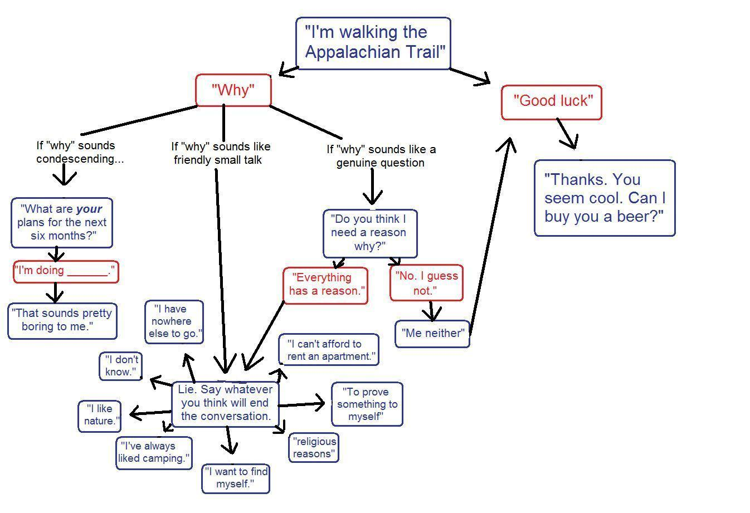

Slide 30
Dialogs = Routing
All bots will have at least one root '/' dialog
Dialog Handlers
Waterfall
Dialog Object

Slide 31
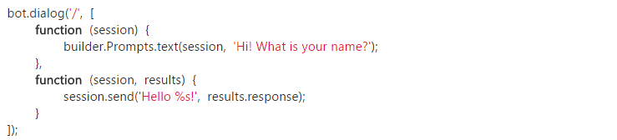
Waterfall
Exactly what it sounds like…

Slide 32
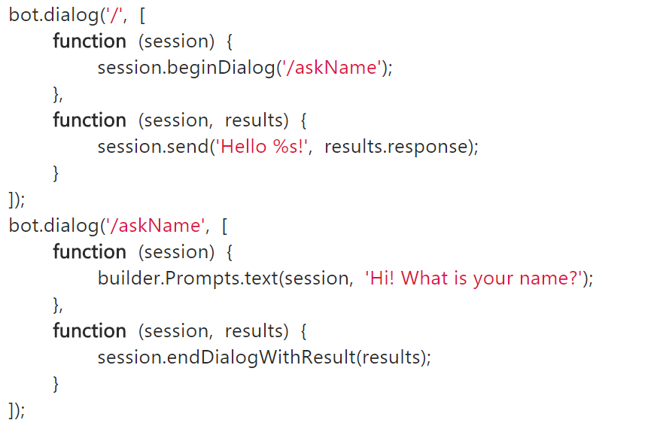
Waterfall
Exactly what it sounds like…

Slide 33
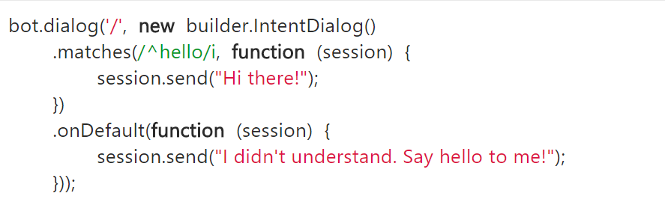
Dialog Object

Slide 34
Prompt types
Dialog Actions
Prompts.text()
DialogAction.send
Prompts.confirm()
DialogAction.beginDialog
Prompts.number()
DialogAction.endDialog
Prompts.time()
DialogAction.validatedDialog
Prompts.choice()
Prompts.attachment()
https://docs.botframework.com/en-us/node/builder/chat/prompts/
https://docs.botframework.com/en-us/node/builder/chat-reference/classes/_botbuilder_d_.dialogaction.html#validatedprompt

Slide 35
Simple Waterfall
var builder = require('botbuilder');
var connector = new builder.ConsoleConnector().listen();
var bot = new builder.UniversalBot(connector);
bot.dialog('/', [
function (session) {
builder.Prompts.text(session, 'Hi! What is your name?');
},
function (session, results) {
session.send('Hello %s!', results.response);
}
]);
Our root dialog '/'
Uses a text prompt to collect name
and put in session.
we use the result of the prompt
to echo back to user (notice that it
is an array of functions in the
dialog)

Slide 36
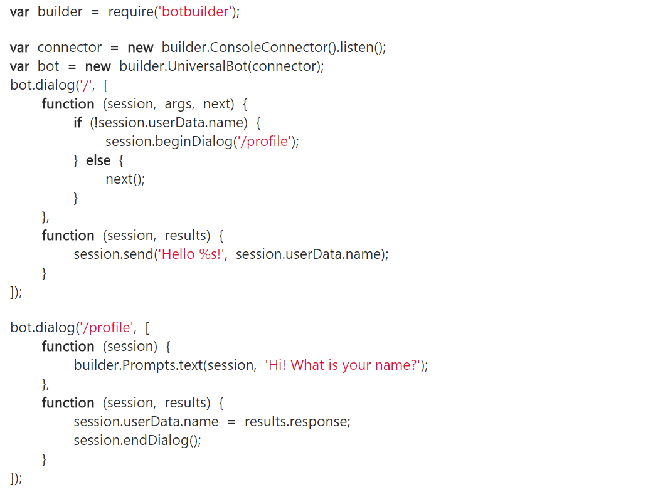
First Run
Nothing new here
Our root dialog '/'
Checks session.userdata
if no username sends to
our '/profile' dialog using
beginDialog()
We use a text prompt to collect
name
once data is collected we call
endDialog()

Slide 37
First Run
Our code flow returns here and
proceeds to the next function
We then address user by name
This whole dialog is not used
next time through

Slide 38
NEW First Run
var builder = require('botbuilder');
var connector = new builder.ConsoleConnector().listen();
var bot = new builder.UniversalBot(connector);
bot.dialog('/', function (session) {
session.send("%s, I heard: %s", session.userData.name, session.message.text);
session.send("Say something else...");
});
// Install First Run middleware and dialog
bot.use(builder.Middleware.firstRun({ version: 1.0, dialogId: '*:/firstRun' }));
bot.dialog('/firstRun', [
function (session) {
builder.Prompts.text(session, "Hello... What's your name?");
},
function (session, results) {
// We'll save the users name and send them an initial greeting. All
// future messages from the user will be routed to the root dialog.
session.userData.name = results.response;
session.endDialog("Hi %s, say something to me and I'll say it back to you.", session.userData.name);
}
]);
First Run Middleware

Slide 39
Persisting Data
userData
stores information globally for the user across all conversations.
conversationData
stores information globally for a single conversation. This data is visible to everyone within the conversation so care should be used to what’s stored there. It’s disabled by default and needs to be enabled using the bots persistConversationData setting.
privateConversationData
stores information globally for a single conversation but its private data for the current user. This data spans all dialogs so it’s useful for storing temporary state that you want cleaned up when the conversation ends.
dialogData
persists information for a single dialog instance. This is essential for storing temporary information in between the steps of a waterfall.

Slide 40
Determining Intent

Slide 41
What do you mean?

Slide 42
Intent Dialogs
Matching Regular Expressions
Intent Recognizers
Entity Recognition
Using Luis

Slide 43
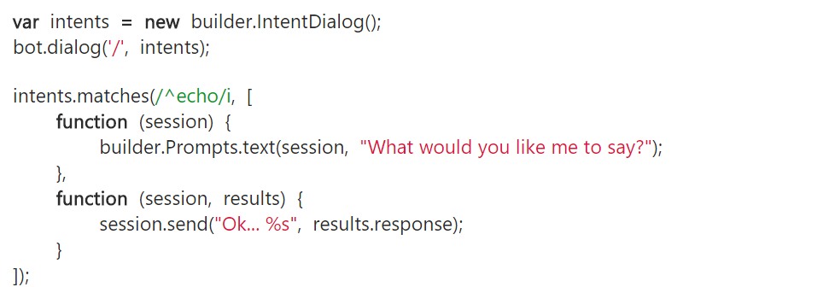
Matching Regular Expressions
New up an IntentDialog() and
pass it to our dialog (instead of a
function)
If we match using a regex then we run that code.
If outside the bot.dialog call use intents.matches

Slide 44
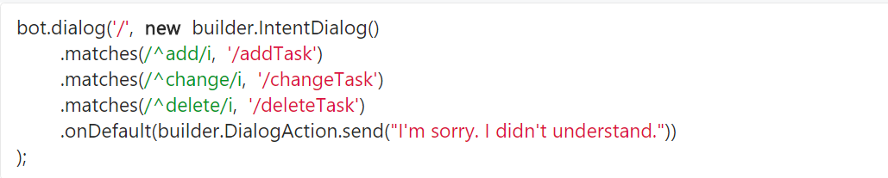
Matching Regular Expressions
If inside the bot.dialog call we can easily stack dialog paths using dot (.) notation

Slide 45
Intent Recognizers
Intent Recognizers

Slide 46
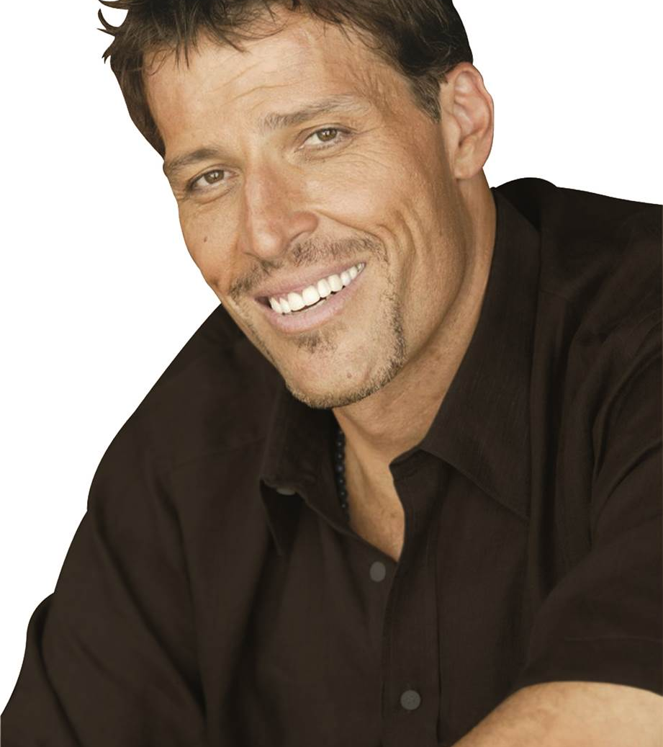
NLP not NLP
Neural Linguistic Programming

Slide 47
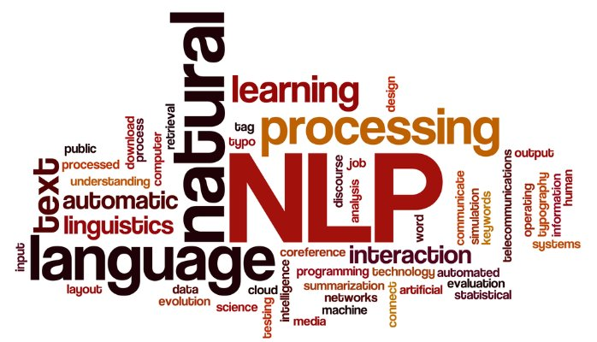
NLP not NLP
Natural Language Processing

Slide 48
Intent Recognizer Interface
Chat Client
Chatbot
What they said
What they meant
Intent
Recognizer
Implements IIntent Interface

Slide 49
LUIS Language Understanding Intelligent Service Determine Intent
Detect Entities
Improve Models

Slide 50
Language Understanding Intelligent Service
LUIS Lets you Create
Language Undersanding Models Specific to your domain
Define
Concepts
Provide
Examples
Deploy
Active Learning

Slide 51
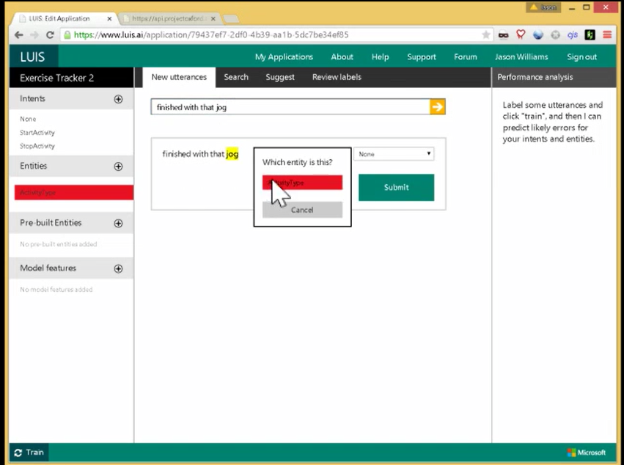

Slide 52
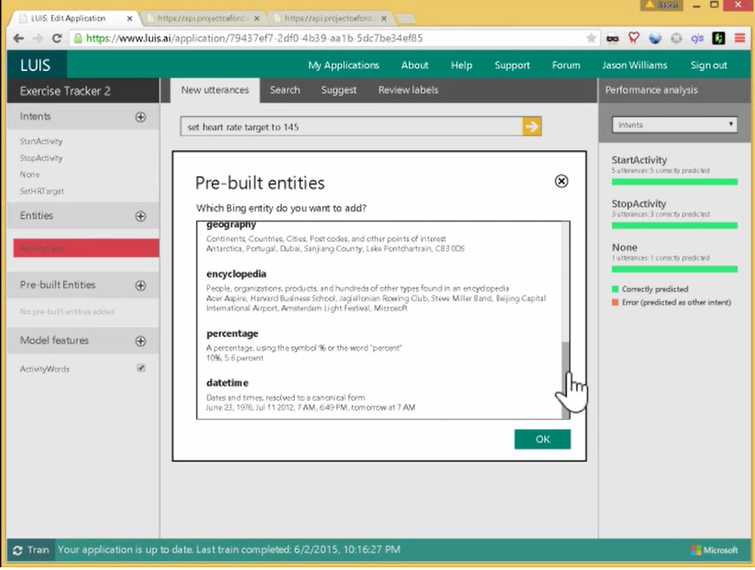

Slide 53
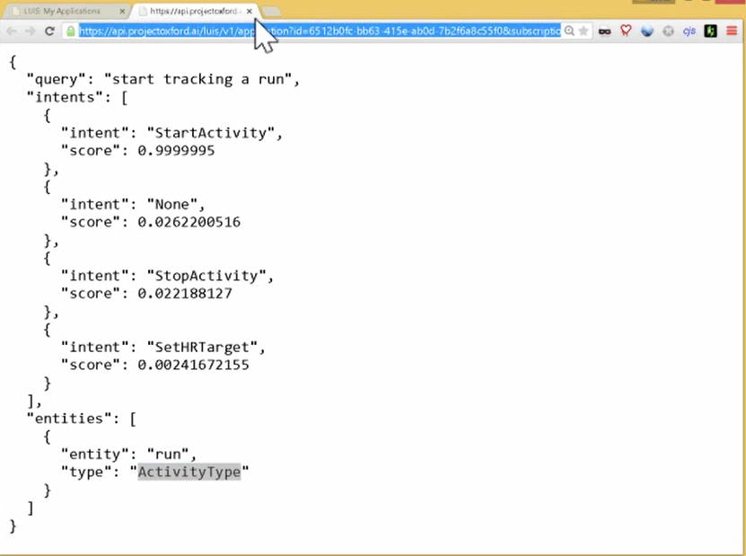

Slide 54
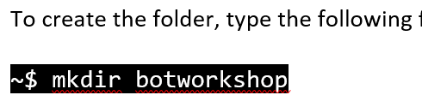
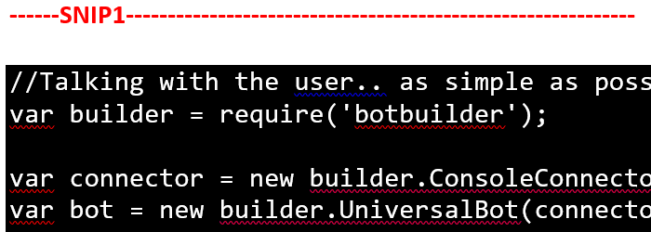
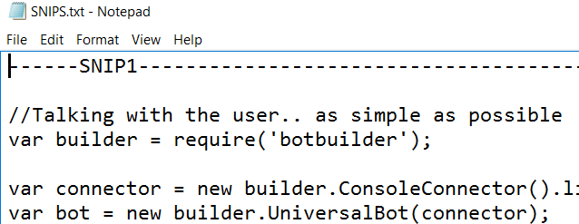
HOL Conventions Used
Don’t type the ~$
If you are using the PDF copy and paste from the txt file NOT the PDF

Slide 55
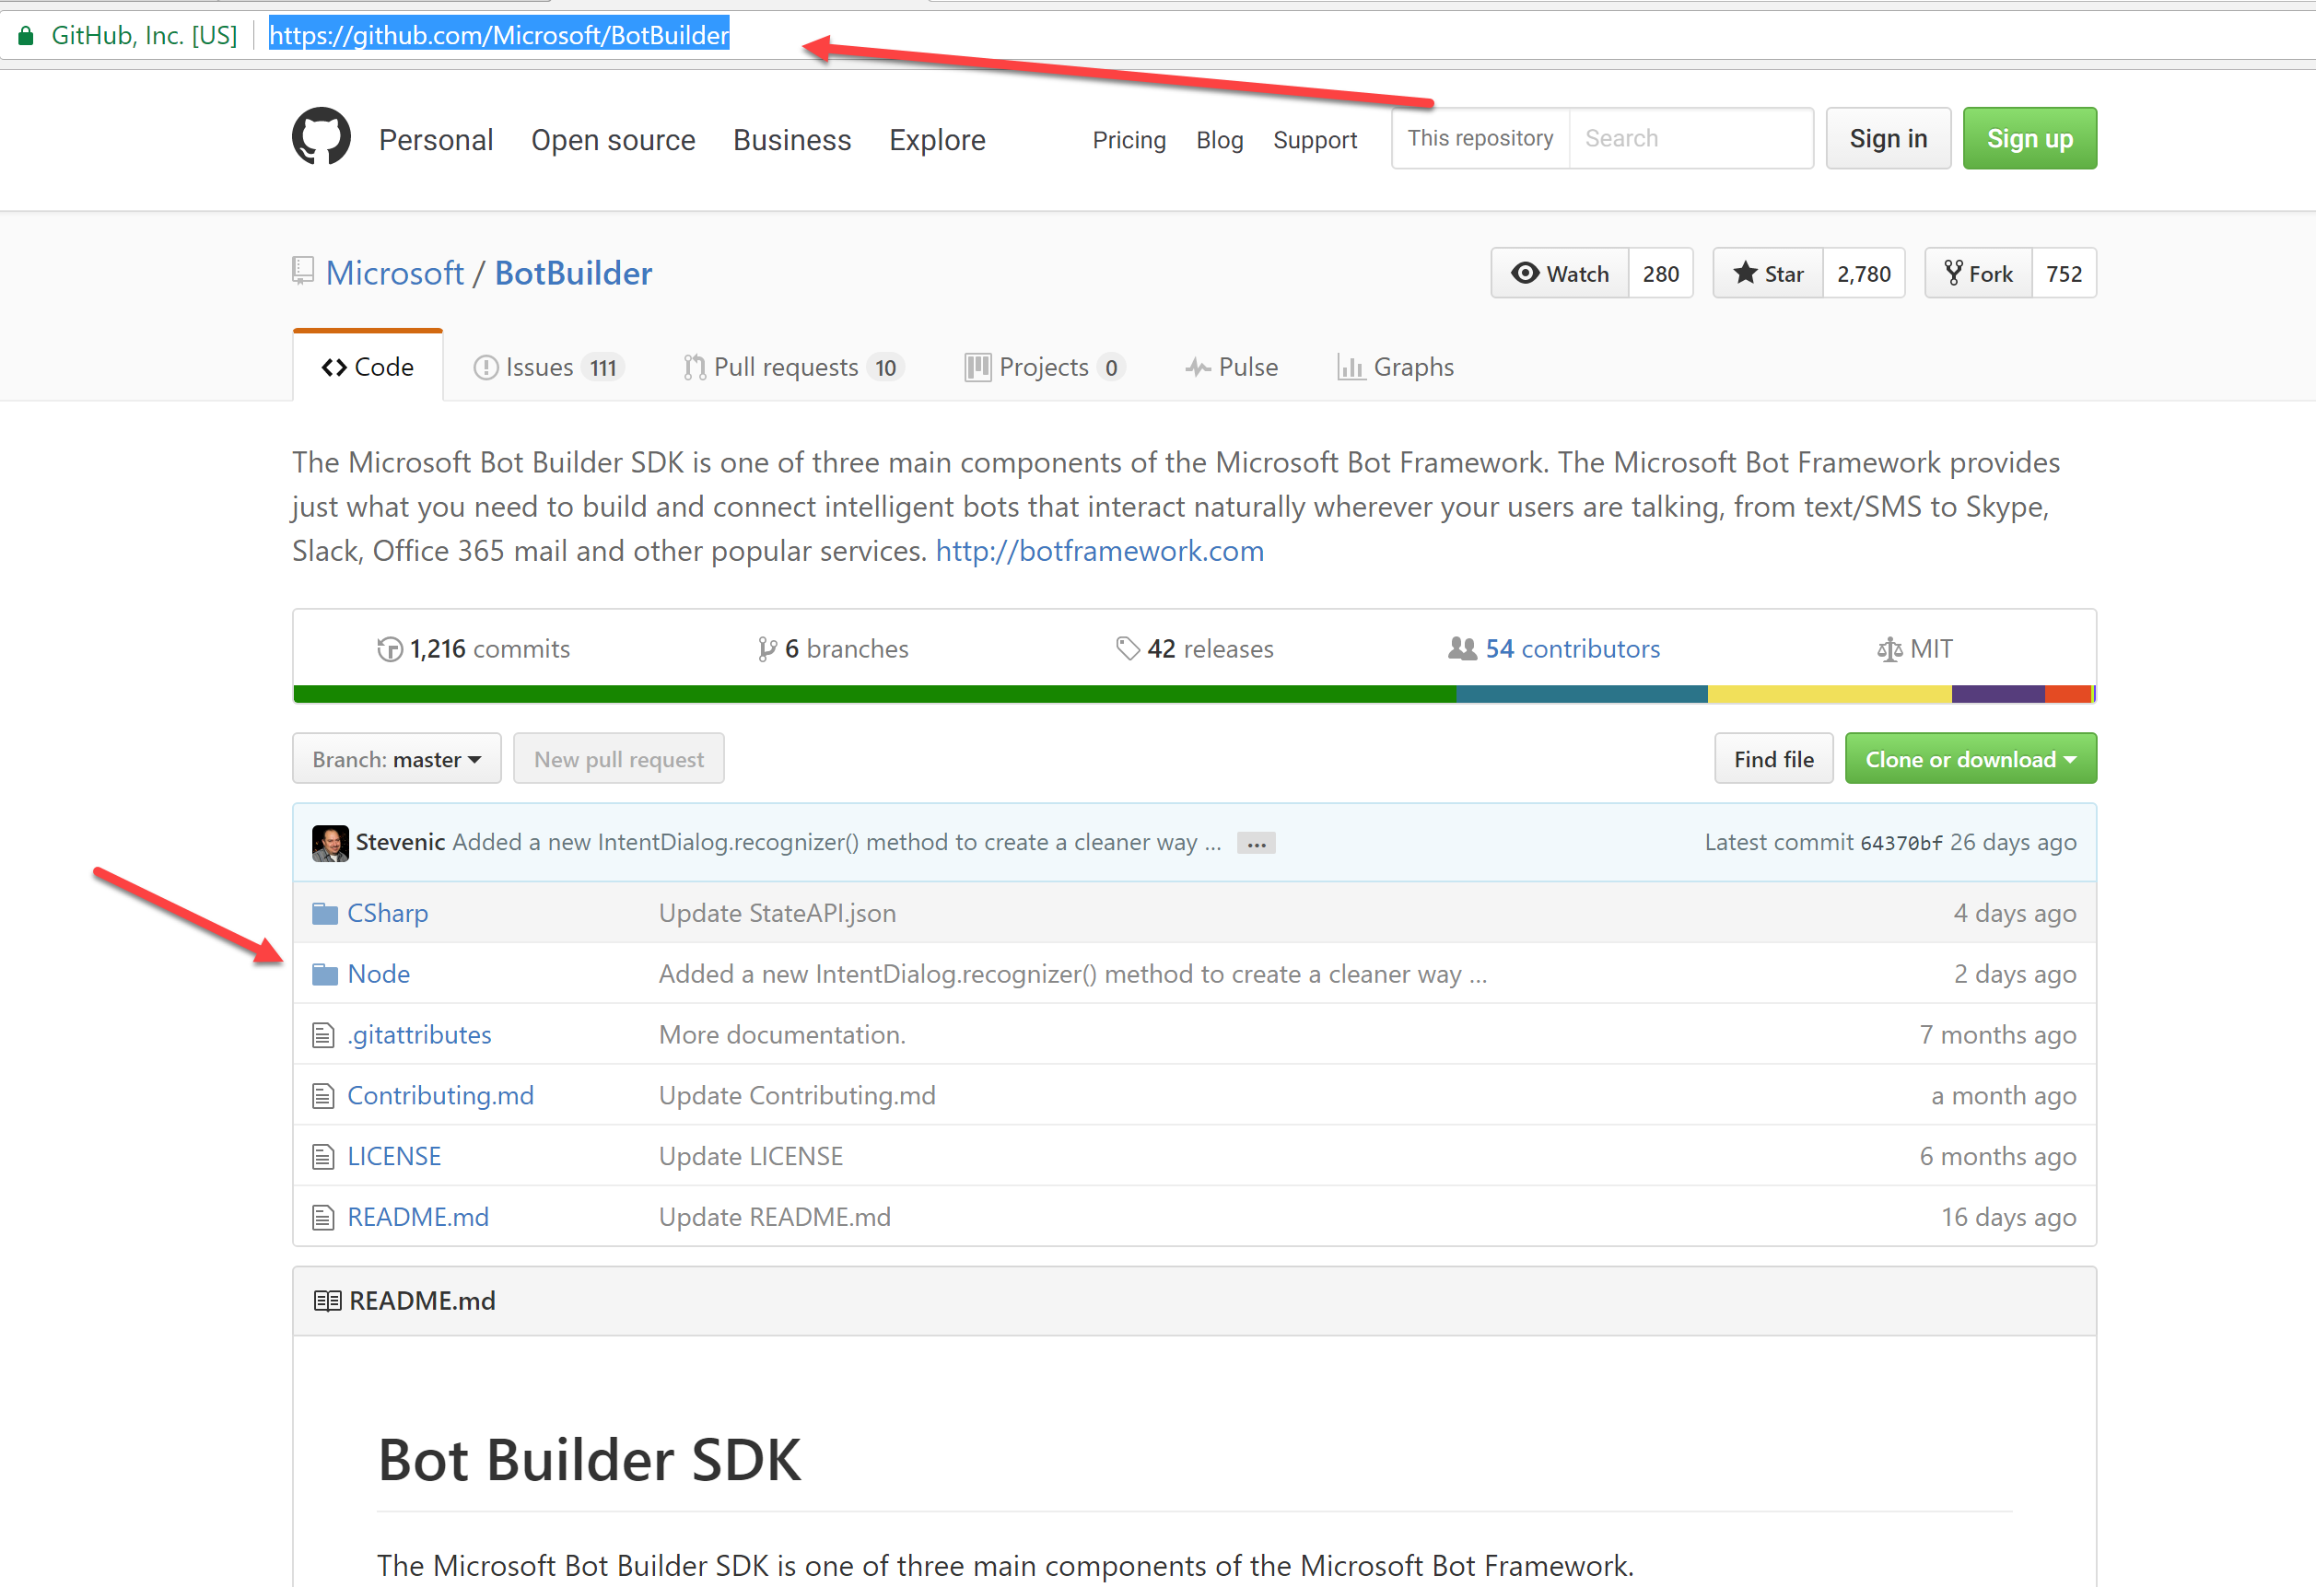
HOL Extras

Slide 56
HOL – Get Started

